Slide 1
Lecture 8
Confidence Intervals for Two-Population Comparison Measures

Slide 2
Section A: Confidence Intervals for Population Comparisons: An Overview

Slide 3
Learning Objectives
Upon completion of this lecture section, you will be able to:
Extend the concept of sampling distributions to include measures of association that compare two populations
Extend to the principles of confidence interval estimation from single population quantities to measures of association comparing two populations
Appreciate that confidence interval computations for ratios need to be done on the natural log scale, and the results then transformed back to the ratio scale
Explain the concept of a null value (value meaning “no association” for such measures of association, and what it’s absence/presence in a confidence interval signifies

Slide 4
Motivation
Frequently, in public health/medicine/science etc.., researchers/practitioners are interested in comparing two (or more) outcomes between populations using data collected on samples from these populations
Such comparisons can be used to investigate questions such as:
How do salaries differ between males and females?
How do cholesterol levels differ across weight groups?
How does AZT impact the transmission of HIV from mother to child
How is a drug associated with survival among patients with a disease?

Slide 5
Motivation
It is not only important to estimate the magnitude of the difference in the outcome of interest between the two groups being compared, but also to recognize the uncertainty in the estimate
The summary measures developed thus far are all sample based, and hence sample statistics: these are subject to sampling error just like single sample summary statistics
One approach to quantifying the uncertainty in these estimates is to create confidence intervals

Slide 6
Motivation
Types of two group comparisons, continuous outcomes
Paired

Slide 7
Motivation
Types of two group comparisons, continuous outcomes
Unpaired

Slide 8
Motivation
Types of two group comparisons, binary outcomes
Unpaired

Slide 9
Motivation
Types of two group comparisons, time-to-event outcomes
Unpaired

Slide 10
Application of CLT
It turns out that differences of two quantities whose distributions is normal, have a normal distribution
As such, we can extend the basic principles of the CLT to understand and quantify the sampling variability
Mean differences between two independent populations
Difference in proportions between two independent populations

Slide 11
Application/Extension of CLT: Differences
It turns out that differences of two quantities whose distributions is normal, have a normal distribution

Slide 12
Application/Extension of CLT: Differences
It turns out that differences of two quantities whose distributions is normal, have a normal distribution

Slide 13
Application/Extension of CLT: Differences
Sampling distributions of differences are normally distributed and centered at true difference (for “large” samples)

Slide 14
Application/Extension of CLT: Ratios
Ratios are a bit different, but relatively easy to handle in terms of sampling distributions

Slide 15
Application/Extension of CLT: Ratios
Ratios are a bit different, but relatively easy to handle in terms of sampling distributions

Slide 16
Application/Extension of CLT: Ratios
Ratios are a bit different, but relatively easy to handle in terms of sampling distributions

Slide 17
Application/Extension of CLT: Ratios
Additionally, on the natural log scale, ratios are expressed as differences

Slide 18
Application/Extension of CLT: Ratios
The sampling distribution for the natural log of a ratio is normally distributed and centered at the natural log of the true, population value of the ratio being estimated

Slide 19
Null Values
The null value for a measure of association comparing two population is the value of this measure if both of the population outcome quantities being compared are equal (and hence there is no association between this outcome and the populations)
Null Values
Differences
Ratios

Slide 20
Null Values and Confidence Intervals
If the null value appears in the confidence interval for a measure of association, then “no association” is a plausible conclusion – it cannot be rule out.

Slide 21
Null Values and Confidence Intervals
If the null value does not appear in the confidence interval for a measure of association, then “no association” is not within the range of possible population level associations: and hence can be ruled out as a possibility

Slide 22
Null Values and Confidence Intervals
If the null value does not appear in the confidence interval for a measure of association, then “no association” is not within the range of possible population level associations: and hence can be ruled out as a possibility
If this occurs the finding is called “statistically significant” (much more detail coming in lectures 9-10)

Slide 23
Summary

Slide 24
Section B: Confidence Intervals for Comparing Means of Continuous Outcomes Between Two Populations

Slide 25
Learning Objectives
In the set of lecture you will learn how to estimate and interpret 95% confidence intervals for a mean difference between two populations under two types of study designs:
Paired: when the two samples drawn from populations under study are linked systematically
Unpaired: when the two samples are drawn from two independent, unlinked populations

Slide 26
Example 1: Paired Comparison
Two different physicians assessed the number of palpable lymph nodes in 65 randomly selected male sexual contacts of men with AIDS or AID-related condition¹
 | Doctor 1 | Doctor 2 | Difference
Mean ( ) | 7.91 | 5.16 | -2.75
sd (s) | 4.35 | 3.93 | 2.83
¹ example based on data taken from Rosner B Fundamentals of Biostatistics, 6th ed. (2005) Duxbury Press. (based on research by Coates, et al. (1988) Assessment of generalized….Journal of Clinical Epidemiology, 41(2).

Slide 27
Example 1: Paired Comparison
Two different physicians assessed the number of palpable lymph nodes in 65 randomly selected male sexual contacts of men with AIDS or AID-related condition : study design and data structure

Slide 28
95% Confidence Interval
95% CI for difference in mean number of lymph nodes, Doctor 2 compared to Doctor 1

Slide 29
95% Confidence Interval
95% CI for difference in mean number of lymph nodes, Doctor 2 compared to Doctor 1: Interpretation
Had all such men been examined by these two physicians, the average difference in number of lymph nodes discovered by the two physicians would be between -3.45 and -2.05
Notice, all possibilities for the true mean difference are negative, and 0 is not included in the interval

Slide 30
95% Confidence Interval
If we had instead done the comparison in the direction of Doctor 1 versus Doctor 2, then:
And the 95% CI for µ_{diff} would be (2.05, 3.45)
This results is not about these two doctors per se: It shows that this diagnostic approach is not reproducible across different examiners: The resulting doctor to doctor differences are not fully explained by sampling variation

Slide 31
Example 2: Paired Comparison
Cereal and cholesterol: 14 males with high cholesterol given oat bran cereal as part of diet for two weeks, and corn flakes cereal as part of diet for two weeks²
 | Corn Flakes | Oat Bran | Difference
Mean ( ) | 171.2 mg/dL | 157.8 | 13.4
sd (s) | 38.7 | 42.5 | 15.5
² example based on data taken from Pagano M. Prinicples of Biostatistics, 2nd ed. (2000) Duxbury Press. (based on research by Anderson J, et al. (1990) Oat Bran Cereal Lowers..….American Journal of Clinical Nutrition, 52.

Slide 32
95% Confidence Interval
Cereal and cholesterol: Study design and data structure

Slide 33
95% Confidence Interval
95% CI for difference in mean LDL, corn flakes vs. oat bran

Slide 34
Example 3: Paired Design
Before versus After Study³
Ten non-pregnant, pre-menopausal women 16-49 years old who were beginning a regimen of oral contraceptive (OC) use had their blood pressures measured prior to starting OC use, and three-months after consistent OC use.¹ The goal of this small study was to see what, if any, changes in average blood pressure were associated with OC use in such women. The data on the following slide shows the resulting pre- and post-OC use systolic BP measurements for the 10 women in the study.
³ Data taken from Rosner B Fundamentals of Biostatistics, 6th ed. (2005) Duxbury Press.

Slide 35
Example 3: Paired Design
Before versus After Study :Data

Slide 36
Example 3: Paired Design
Before versus After Study :95% CI for µ_{diff}
(1.5 mmHg, 8.1 mmHg)
Interpretation Issue(s)

Slide 37
Example 4:Unpaired (Two Independent Groups)
Hospital length of stay, by age of first claim (Heritage Health³)

Slide 38
Example 4:Unpaired (Two Independent Groups)
Hospital length of stay, by age of first claim (Heritage Health): Data Structure

Slide 39
Example 4: Confidence Intervals
Mean Difference
Need to estimate standard error of this mean difference; data is not paired

Slide 40
Example 4: Confidence Intervals
Estimated standard error
95% CI

Slide 41
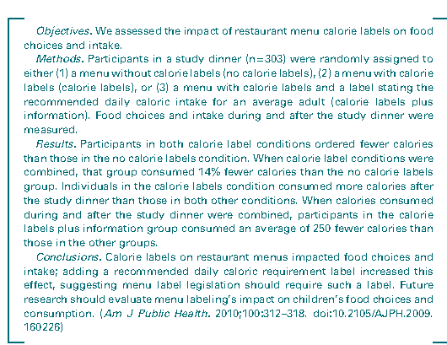
Example 5: Unpaired (Two Independent Groups)
Menu Labeling and Calorie Intake⁴
⁴ Roberto C, et al. Evaluating the Impact of Menu Labeling on Food Choices and Intake. American Journal of Public Health (2010); 100(2); 313-318.
Notes:
100

Slide 42
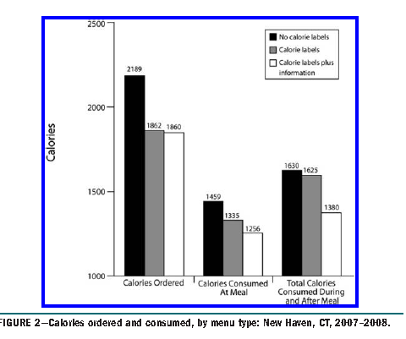
Example 5: Unpaired (Two Independent Groups)
Figure from article (plus information from a separate table)
Notes:
100

Slide 43
Example 5: Unpaired (Two Independent Groups)
Resulting mean differences and 95% CIs
95% CI (-216.7, 226.7)
95% CI (45.3 , 454.7)
95% CI (62.0, 448.0)
Notes:
100

Slide 44
A Note About Unpaired Studies and Results
The last example we looked at in this lecture section is from a randomized trial: As such, we can cleanly conclude that the resulting differences are because of the investigator allocated “intervention” (conversely, where no differences been shown, we could conclude the “intervention” was ineffective)
In non-randomized group comparisons, the interpretations will have to be done with the knowledge that other factors may be reason for an association (difference) or no association (no difference)
Notes:
100

Slide 45
A Note About Unpaired Studies and Results
For “smaller samples” slight corrections need to made to the number of estimated standard errors added and subtracted to get 95% coverage
Notes:
100

Slide 46
Summary
95% (and other level CIs) can relatively easily be estimated for mean differences between two populations for both paired and unpaired study designs
The resulting 95% confidence intervals are interpretable as a range of plausible values for the true difference in population means for the populations from which the samples were taken. The CIs allow for one to ascertain whether there is a real, non-zero difference between the populations being compared, after accounting for sampling variability in the sample mean estimates.
Notes:
100

Slide 47
Summary
As with everything in research, the statistical results have to be translated into scientific/substantive terms, and this includes considering aspects of the study design
Notes:
100

Slide 48
Section C: Confidence Intervals for Binary Comparisons: Part 1, Difference in Proportions (Risk Difference)

Slide 49
Learning Objectives
Upon completion of this lecture section you will be able to:
Estimated and interpret a 95% confidence interval for a difference in proportions between two independent populations
(there is a paired type of study design for binary outcomes, but it is rarely used, so we will not consider it in this course)

Slide 50
Example 1¹
Response to therapy in random sample of 1,000 HIV+ positive patients from a citywide clinical population
206 patients responded
¹ http://inclass.kaggle.com/

Slide 51
Example 1
Summary of response (y/n) by baseline CD4 count (≥ 250 vs. < 250)
Start with sample proportions:
 | CD4 <250 | CD4 ≥ 250
Respond | 127 | 79 | 206
Not Respond | 376 | 418 | 794
 | 503 | 497 | 1,000

Slide 52
Example 1
Summary Measure 1: the difference in proportions (also called risk difference , or attributable risk)
Interpretation(s):
9% (estimated) greater (absolute) response to therapy in CD4<250 group as compared to CD4 ≥ 250 group
9% (estimated) greater absolute “risk” of response to therapy in CD4<250 group as compared to CD4 ≥ 250 group

Slide 53
Example 1
Summary Measure 1: estimating a confidence interval for the difference in proportions

Slide 54
Example 1
Summary Measure 1: estimating a confidence interval for the difference in proportions

Slide 55
Example 1
Summary Measure 1: interpreting a confidence interval for the difference in proportions
Interpretation(s):
9% (estimated) greater (absolute) response to therapy in CD4<250 group as compared to CD4 ≥ 250 group. After accounting for sampling variability this response could be between 4% and 14% greater in the population. (9% (estimated) greater absolute “risk” of response to therapy in CD4<250 group as compared to CD4 ≥ 250 group. After accounting for sampling variability…)

Slide 56
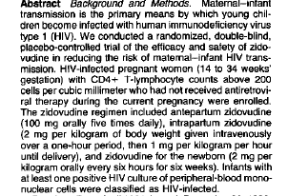
Example 2: Maternal/Infant HIV Transmission²
Randomized Trial: HIV positive pregnant women randomized to receive AZT or placebo
²Connor E, et al. Reduction of Maternal-Infant Transmission of Human Immunodeficiency Virus Type 1 with Zidovudine Treatment. New England Journal of Medicine (1994). 331(18); 1173-1180

Slide 57


Example 2: Maternal/Infant HIV Transmission²
Results
(at 18 mos) | AZT | Placebo
HIV+ | 13 | 40 | 53
HIV- | 167 | 143 | 310
 | 180 | 183 | 363

Slide 58
Example 2
Summary Measure 1: the difference in proportions (also called risk difference , or attributable risk)
Interpretation(s):
15% (absolute) reduction in HIV+ transmission to children born to mothers given AZT as compared to children born to mothers given placebo
15% lower absolute “risk” of HIV+ transmission to children born to mothers given AZT…

Slide 59
Example 2
Summary Measure 1: estimating a confidence interval for the difference in proportions

Slide 60
Example 2
Summary Measure 1: estimating a confidence interval for the difference in proportions

Slide 61
Example 2
Summary Measure 1: interpreting a confidence interval for the difference in proportions
The proportion of infants who tested positive for HIV within 18 months of birth was seven percent (95% CI 4 -12%) in the AZT group and twenty-two percent in the placebo group (95% CI 16 - 28%). This is an absolute decrease of 15% associated with AZT.
The study results estimate the absolute decrease in the proportion of HIV positive infants born to HIV positive mothers associated with AZT to be as low as 8% and as high as 22%

Slide 62
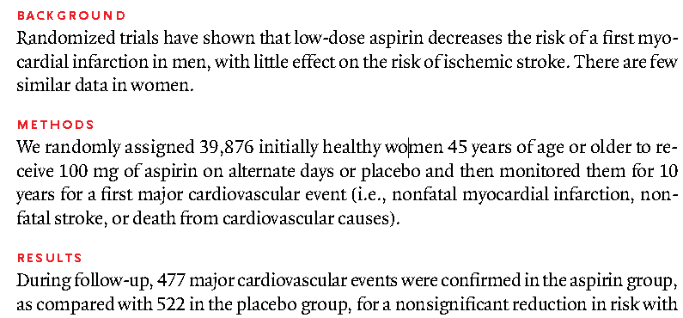
Example 3: Aspirin and CVD: Women³
From Abstract
³ Ridker P, et al. A Randomized Trial of Low-Dose Aspirin in the Primary Prevention of Cardiovascular Disease in Women. New England Journal of Medicine (2005). 352(13); 1293-1304

Slide 63
Example 3
2X2 table and estimates
 | Aspirin | Placebo
CVD | 477 | 522 | 999
No CVD | 19,457 | 19,420 | 38,887
 | 19,934 | 19,942 | 39,876

Slide 64
Example 3
Risk Difference
0.2 % (absolute) reduction in (10-year) risk of CVD for women on low-dose aspirin therapy compared to women not on low dose therapy
In a population of 100,000 women, we would expect to see 0.002*100,000=200 fewer cases of CVD (developing within 10 years) if the women were given low-dose aspirin therapy

Slide 65
Example 3
Risk Difference, 95% CI
In a group of 100,000 women, we would expect to see 0.002*100,000=200 fewer cases of CVD (developing within 10 years) if the women were given low-dose aspirin therapy, but at the population level (ie: accounting for study sampling error) the association could range from a 500 fewer cases to 80 more cases if the women were given low-dose aspirin therapy: As such, after accounting for sampling variability, there is no population level association between low dose aspirin therapy and CVD.

Slide 66
HRT and Risk of CHD
HRT and Risk of CHD⁴
Proportion of Women Developing CHD (Incidence)
4 Writing Group for the Women’s Health Initiative Investigators. Risks and Benefits of Estrogen Plus Progestin in Healthy Postmenopausal Women: Principal Results From the Women's Health Initiative Randomized Controlled Trial. (2002) JAMA.;288(3):321-333.
 | HRT | Placebo
CHD | 163 | 122 | 285
No CHD | 8,345 | 7,980 | 16,325
 | 8,508 | 8,102 | 16,610

Slide 67
HRT and Risk of CHD
Results
Risk Difference:
95% CI:

Slide 68
Summary
Computing confidence intervals for risk differences comparing two unpaired populations is very similar to computing confidence intervals for mean differences comparing two unpaired populations
The resulting confidence interval gives a range of possible values for the risk difference (attributable) between the two populations from which the two samples being compared are taken
With randomized studies, the resulting confidence interval can estimate a range for the absolute impact of an intervention/treatment on a group of known size

Slide 69
Section D: Confidence Intervals for Binary Comparisons: Part 2: Ratio of Proportions (Relative Risk), and Odds Ratios

Slide 70
Learning Objectives
Upon completion of this lecture section you will be able to:
Estimate 95% confidence intervals (and other levels) for relative risks and odds ratios by hand
Explain the relationship between the null value of 0 regarding the confidence intervals for the natural log of ratios, and the null value of 1 for the ratios
Explain how the confidence intervals for the difference in proportions, relative risk and odds ratio estimated from the same data sample should agree in terms of including/not including the respective null values

Slide 71
Example 1¹
Summary of response (y/n) by baseline CD4 count (≥ 250 vs. < 250)
Start with sample proportions:
¹ http://inclass.kaggle.com/
 | CD4 <250 | CD4 ≥ 250
Respond | 127 | 79 | 206
Not Respond | 376 | 418 | 794
 | 503 | 497 | 1,000

Slide 72
Example 1
Summary Measure 1: the difference in proportions (also called risk difference , or attributable risk), and confidence interval

Slide 73
Example 1
Summary Measure 2: the ratio of proportions (also called relative risk, or risk ratio)

Slide 74
Example 1: CI for Relative Risk
Summary Measure 2: estimating a 95% confidence interval for the ratio of proportions (also called relative risk, or risk ratio)
 | Group 1 | Group 2
Outcome Y | a | b | a+b
Outcome N | c | d
 | a+c | b+d | a+b+c+d

Slide 75
Example 1: CI for Relative Risk
Summary Measure 2: estimating a 95% confidence interval for the ratio of proportions (also called relative risk, or risk ratio)
 | CD4 <250 | CD4 ≥ 250
Respond | 127 | 79 | 206
Not Respond | 376 | 418 | 794
 | 503 | 497 | 1,000

Slide 76
Example 1: CI for Relative Risk
Summary Measure 2: estimating a 95% confidence interval for the ratio of proportions (also called relative risk, or risk ratio)

Slide 77
Example 1: CI for Relative Risk :Interpretation
Summary Measure 2: 95% confidence interval for the ratio of proportions : Interpretation
Based on the results of this study, HIV positive individuals with CD4 counts of 250 or more at the time of starting therapy, have 56% greater risk (probability) of responding to therapy when compared to HIV positive individuals with CD4 counts of less than 250 at the start of therapy. Additionally, these results estimate that this increase in response probability (risk) could be as small as 20% and as large as 101%.

Slide 78
Example 1: CI for Odds Ratio
Summary Measure 3: estimating a 95% confidence interval for the odds ratio (also called relative odds)
 | Group 1 | Group 2
Outcome Y | a | b | a+b
Outcome N | c | d
 | a+c | b+d | a+b+c+d

Slide 79
Example 1: CI for Odds Ratio
Summary Measure 3: estimating a 95% confidence interval the odds ratio (also called relative odds)
 | CD4 <250 | CD4 ≥ 250
Respond | 127 | 79 | 206
Not Respond | 376 | 418 | 794
 | 503 | 497 | 1,000

Slide 80
Example 1: CI for Odds Ratio
Summary Measure 3: estimating a 95% confidence interval the odds ratio (also called relative odds)

Slide 81
Example 1: CI for Odds Ratio: Interpretation
Summary Measure 3: estimating a 95% confidence interval the odds ratio (also called relative odds): INTEPRETATION
Based on the results of this study, HIV positive individuals with CD4 counts of less than 250 at the time of starting therapy have 75% greater odds of responding to therapy when compared to HIV positive individuals with CD4 counts of 250 or greater at the start of therapy. Additionally, these results estimate that this increase in response odds could be as small as 27% and as large as 141%.

Slide 82
Example 1: All Three CIs
All three estimates and CIs

Slide 83
Example 2: Maternal/Infant HIV Transmission²
Results
(at 18 mos) | AZT | Placebo
HIV+ | 13 | 40 | 53
HIV- | 167 | 143 | 310
 | 180 | 183 | 363

Slide 84
Example 2
Summary Measure 1: the difference in proportions (also called risk difference , or attributable risk)

Slide 85
Example 2
Summary Measure 2: the ratio of proportions (also called relative risk, or risk ratio)
Risk of mother/child HIV transmission for mothers given AZT is 0.32 times the chances (risk) of mother/child HIV transmission for mothers given placebo
68% lower relative risk of mother/child HIV transmission for mothers given AZT

Slide 86
Example 2
Summary Measure 2: estimating a 95% confidence interval the ratio of proportions (also called relative risk, or risk ratio)
 | Group 1 | Group 2
Outcome Y | a | b | a+b
Outcome N | c | d
 | a+c | b+d | a+b+c+d

Slide 87
Example 2
Summary Measure 2: estimating a 95% confidence interval the ratio of proportions (also called relative risk, or risk ratio)
(at 18 mos) | AZT | Placebo
HIV+ | 13 | 40 | 53
HIV- | 167 | 143 | 310
 | 180 | 183 | 363

Slide 88
Example 2
Summary Measure 2: estimating a 95% confidence interval the ratio of proportions (also called relative risk, or risk ratio)

Slide 89
Example 2
Summary Measure 2: 95% confidence interval the ratio of proportions (also called relative risk, or risk ratio): Interpretation
An HIV positive pregnant woman could reduce her personal risk of giving birth to an HIV positive child by nearly 70% if she takes AZT during her pregnancy . Study results suggest that this reduction in risk could be as small as 42% and as large as 82%

Slide 90
Example 2
Summary Measure 3: the odds ratio
 | Group 1 | Group 2
Outcome Y | a | b | a+b
Outcome N | c | d
 | a+c | b+d | a+b+c+d

Slide 91
Example 2
Summary Measure 3: the odds ratio

Slide 92
Example 2
95% CI for the odds ratio: Interpretation
AZT is associated with an estimated 72% (estimated OR = .28) reduction in odds of giving birth to an HIV infected child among HIV infected pregnant women. Study results suggest that this reduction in odds could be as small as 47% and as large as 86%.

Slide 93
Example 1: All Three CIs
All three estimates and CIs

Slide 94
Example 3: Aspirin and CVD: Women³
From Abstract
³ Ridker P, et al. A Randomized Trial of Low-Dose Aspirin in the Primary Prevention of Cardiovascular Disease in Women. New England Journal of Medicine (2005). 352(13); 1293-1304

Slide 95
Example 3
2X2 of results
 | Aspirin | Placebo
CVD | 477 | 522 | 999
No CVD | 19,457 | 19,420 | 38,887
 | 19,934 | 19,942 | 39,876

Slide 96
Example 3
Summary Measure 1: Risk Difference (95% CI)
Summary Measure 2: Relative Risk (95% CI)
Summary Measure 3: Odds Ratio (95% CI)

Slide 97
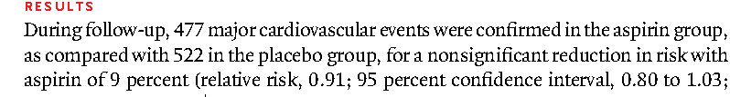
Example 3
Results

Slide 98
Example 4
HRT and Risk of CHD
Proportion of Women Developing CHD (Incidence)
 | HRT | Placebo
CHD | 163 | 122 | 285
No CHD | 8,345 | 7,980 | 16,325
 | 8,508 | 8,102 | 16,610

Slide 99
Example 4
Summary Measure 1: Risk Difference (95% CI)
Summary Measure 2: Relative Risk (95% CI)
Summary Measure 3: Odds Ratio (95% CI)

Slide 100
Summary
Confidence intervals for ratio based measures of association with binary outcomes, both the relative risk and odds ratio, need to computed on the natural log scale, and then the results exponentiated (anti-logged) back to the ratio scale
The computations on the log scale are “business as usual” : the estimate plus/minus 2 estimated standard errors
The resulting estimates of the difference in proportions, relative risk and odds ratio based on the same data will all agree in terms of the direction of association; the resulting confidence intervals will all agree with inclusion/exclusion of the “null” value (value meaning no difference/no association)

Slide 101
Section E: Confidence Intervals for Incidence Rate Ratios

Slide 102
Learning Objectives
Upon completion of this lecture section you will be able to
Estimate and interpret a 95% (or other level) confidence interval for an incidence rate ratio comparing time-to-event outcomes between two populations

Slide 103
Example 1
Mayo Clinic: Primary Biliary Cirrhosis (PBC treatment), randomized clinical trial¹
Primary Research Question: How does mortality (and hence) survival for PBC patients randomized to receive DPCA (D-Penicillamine) compare to survival for PBC patients randomized to received a placebo?
1 Dickson E, et al. Trial of Penicillamine in Advanced Primary Biliary Cirrhosis. New England Journal of Medicine. (1985) 312(16): 1011-1015

Slide 104
Example 1
Incidence rates for DPCA and placebo groups
DPCA: 872.5 years of follow-up, 65 deaths,n=158
Placebo: 842.5 years of follow-up, 60 deaths, n=154
\

Slide 105
Example 1
Incidence Rate Ratio
Intepretations:
- The risk of death in the DPCA group (in the study follow-up period) is 1.06 time the risk in the placebo group
- Subjects in the DPCA groups had 6% higher risk of death in the follow-up period when compared to the subjects in the placebo group

Slide 106
Example 1
How to get a 95% CI?
Because the IRR is a ratio, the first step is to compute the 95% for the natural log of the IRR
95% CI for ln(IRR)

Slide 107
Example 1
How to get a 95% CI?
Estimate standard error of
, where E₁ = # events, group 1
E₂ = # events, group 2
So for these data: E_{DPCA}= 65 deaths, E_{Placebo}= 60 deaths

Slide 108
Example 1
How to get a 95% CI?
95% CI for ln(IRR)
95% CI for IRR

Slide 109
Example 1
Interpretation
In this study, the 158 subjects with primarily biliary cirrhosis (PBC) randomized to receive the drug DPCA had a slightly elevated risk of death when compared to the 154 such subjects randomized to the placebo group (IRR = 1.06). After accounting for sampling variability, however, there is no evidence of an association between DPCA and death in the population of patients with PBC. (95% CI for IRR: 0.74 to 1.52)

Slide 110
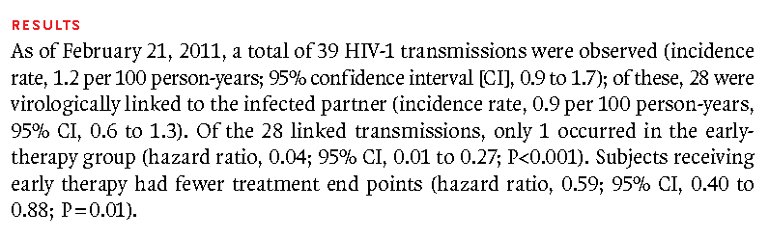
Example 2
ART and Partner to Partner HIV Transmission²
2 Cohen M, et al. Prevention of HIV-1 Infection with Early Antiretroviral Therapy. New England Journal of Medicine. (2011) 365(6): 493-505

Slide 111
Example 2
ART and Partner to Partner HIV Transmission
“Of the 28 linked transmissions, only 1 occurred in the early therapy group (hazard ratio 0.04…)”
Note: hazard ratio and incidence rate ratio are (nearly) synonymous
So,

Slide 112
Example 2
ART and Partner to Partner HIV Transmission
- HIV discordant (at baseline) couples in which the HIV+ partner was given early ART therapy had 0.04 times the risk of within couple transmission as compared to couples in which the HIV+ partner was given standard therapy
- HIV discordant (at baseline) couples in which the HIV+ partner was given early ART therapy had 96% lower risk of within couple transmission as compared to couples in which the HIV+ partner was given standard therapy

Slide 113
Example 2
ART and Partner to Partner HIV Transmission
95% CI for IRR

Slide 114
Example 2
Interpretation (I will use the results I computed)
In a study of 1,763 HIV sero-discordant couples, the risk of partner-to-partner transmission among the 866 randomized to receive early ART therapy was 96% lower than among the 877 randomized to receive standard ART therapy. After accounting for sampling variability, the early ART therapy could reduce risk of partner transmission from 69% to 99% at the population level.

Slide 115
Section F: A Brief Note About Ratios, Part 2

Slide 116
Overview
Recall, from the first “Brief Note about Ratios” , and lecture 8D:
The scaling of ratios is not symmetric around the value of 1 (which would indicate equal values in the numerator and denominator)
On the log scale (we use natural log, ln) the values of ln(ratios) are symmetric about the value 0

Slide 117
Implications for Confidence Intervals
This rescaling to the “egalitarian” log scale, also means that the confidence interval limits are comparable on the log scale for both positive and negative associations

Slide 118
Example 1
Recall the Results
(at 18 mos) | AZT | Placebo
HIV+ | 13 | 40 | 53
HIV- | 167 | 143 | 310
 | 180 | 183 | 363

Slide 119
Example 1
Relative risk and 95% CI presented in both directions of comparison:

Slide 120
Example 1
On the log scale, the ln(0.32) = -ln(3.1)
Regardless of direction of comparison, the standard error estimate of the ln(RR) the same!

Slide 121
Example 1
RR₁
RR₂
(at 18 mos) | AZT | Placebo
HIV+ | 13 | 40 | 53
HIV- | 167 | 143 | 310
 | 180 | 183 | 363
(at 18 mos) | Placebo | AZT
HIV+ | 40 | 13 | 53
HIV- | 143 | 167 | 310
 | 183 | 180 | 363

Slide 122
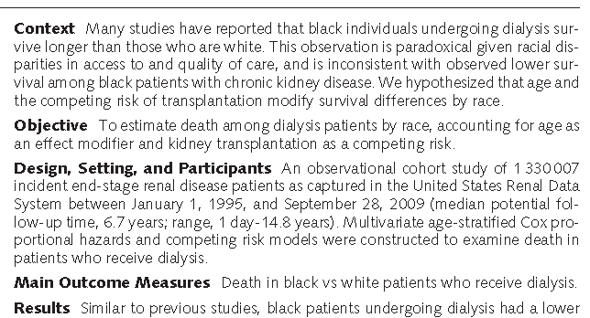
Example 2²
Mortality on Dialysis, Race and Age
2 Kucircka L et al. Association of Race and Age With Survival Among Patients Undergoing Dialysis. Journal of the American Medical Association (2011) Vol. 306, No. 6, 620-626.

Slide 123
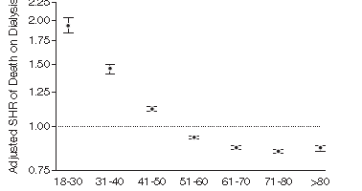
Studies Involving Follow-Up Over Time: Example 4
IRR estimates for mortality in follow-up period (black versus white), presently separately across age groupings (adjusted), presented on log scale

Slide 124
Studies Involving Follow-Up Over Time: Example 4
IRR estimates for mortality in follow-up period (black versus white), presently separately across age groupings (adjusted), presented on log scale

Slide 125
Summary

Slide 126
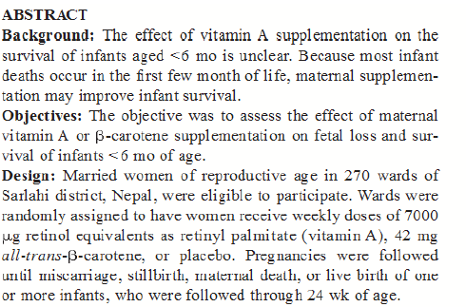
Example 3
Maternal Vitamin Supplementation and Infant Mortality³
3 Katz J, West K et al. Maternal low-dose vitamin A or β-carotene supplementation has no effect on fetal loss and early infant mortality: a randomized cluster trial in Nepal. American Journal of Clinical Nutrition (2000) Vol. 71, No. 6, 1570-1576.

Slide 127
Studies Involving Follow-Up Over Time: Example 3
Incidence Rate Ratio: 3 have three groups, can make 1 the “reference” or comparison group: I suggest placebo as the reference group

Slide 128
Studies Involving Follow-Up Over Time: Example 3
Incidence Rate Ratios with 95% CIS:

Slide 129
Summary
The 95% CI for an incidence rate ratio (IRR) can be computed by creating a 95% CI for the ln(IRR) and exponentiating (anti-logging) the results
The 95% CI for the IRR gives a range of possible values for the true incidence rate ratio for the populations being compared by the two samples
As with the relative risk and odds ratio (the IRR is really a RR that includes information about “time at risk”), the null value for the IRR is 1

